Slide 1
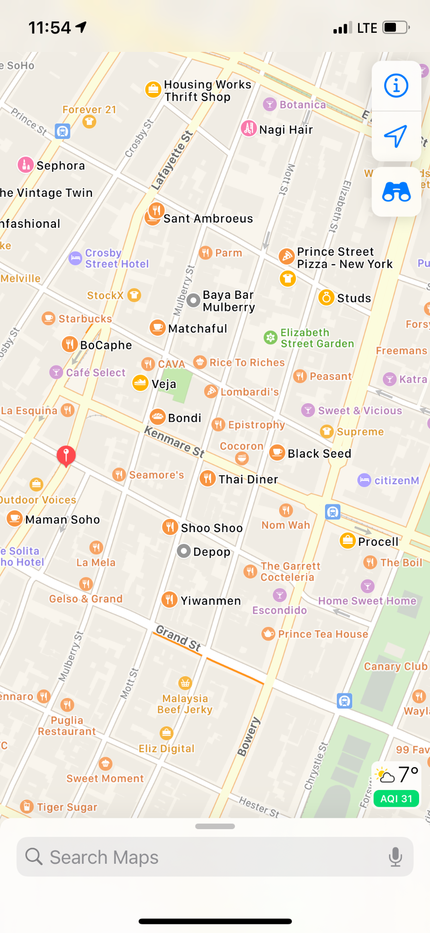
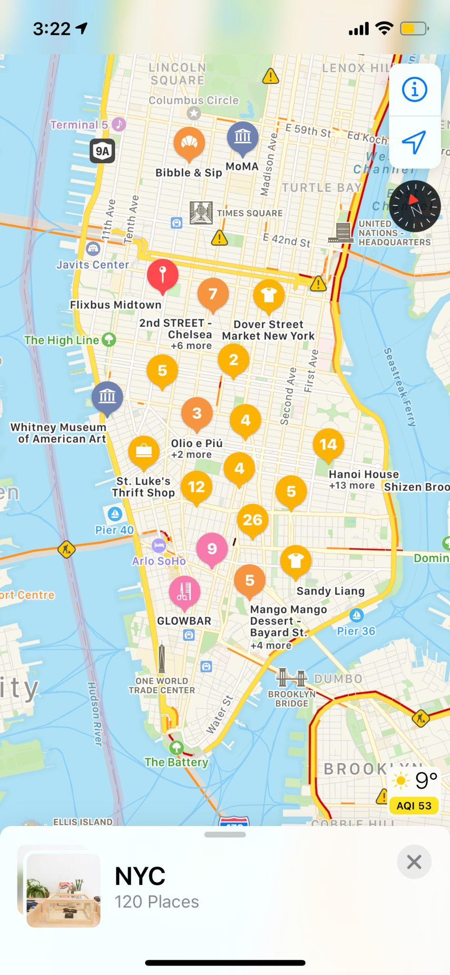
1

Slide 2

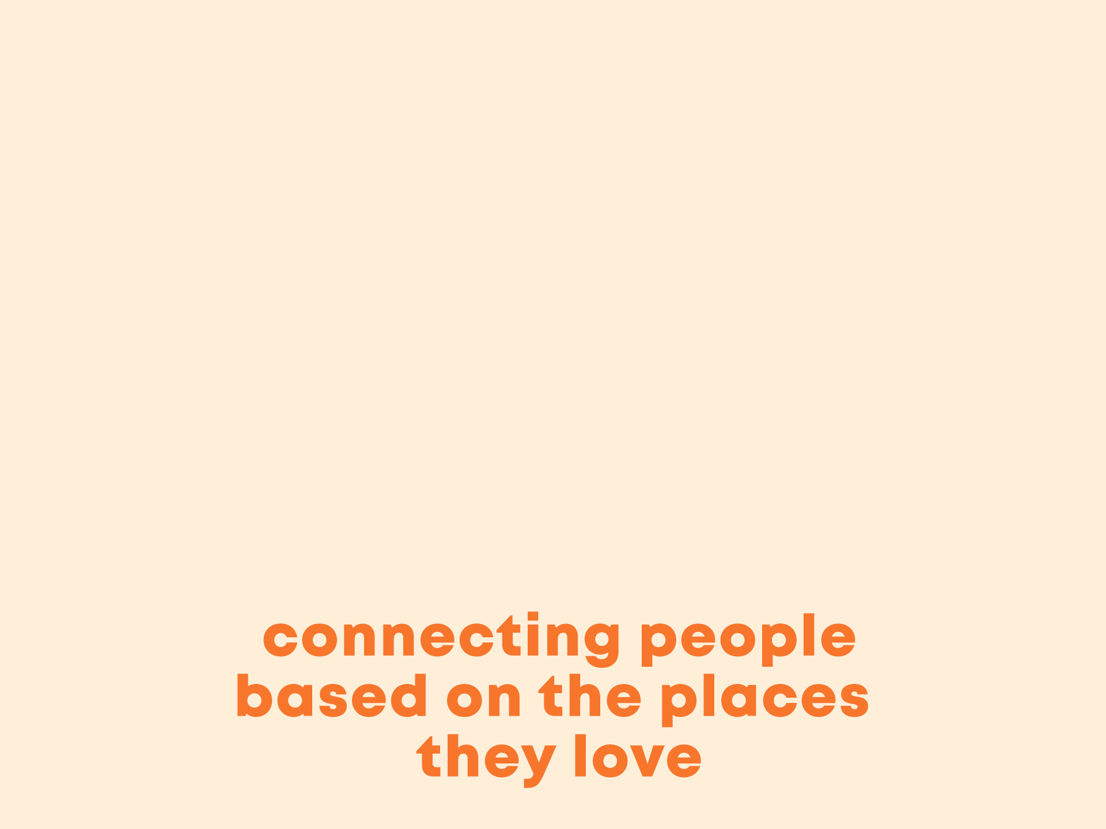
2

Slide 3
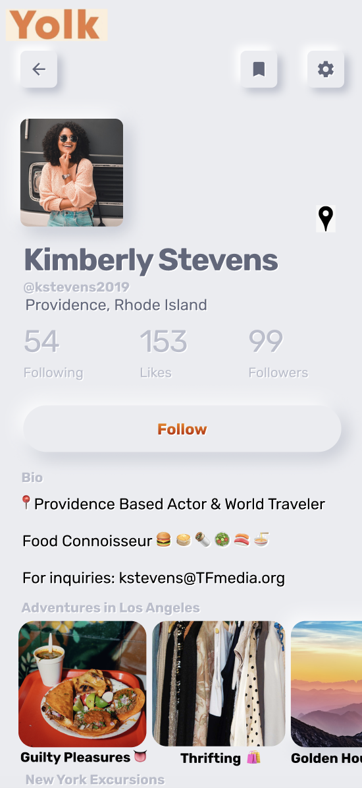
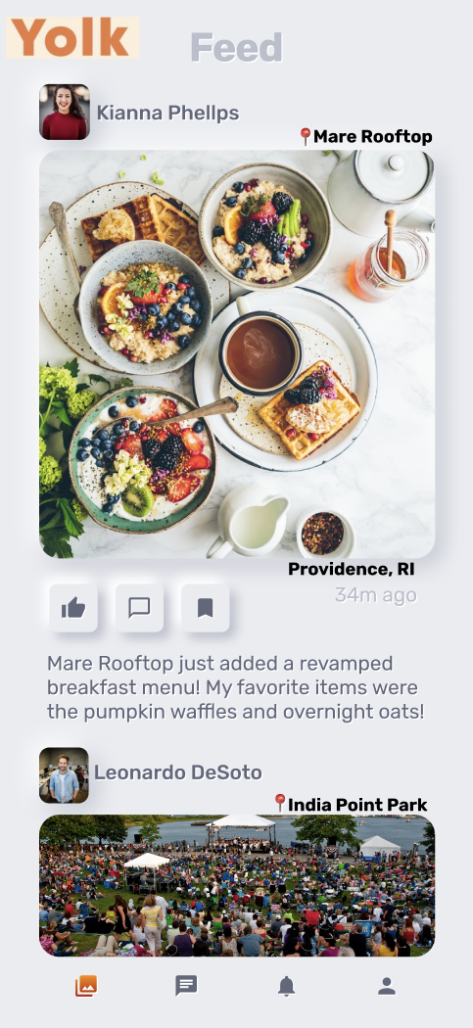
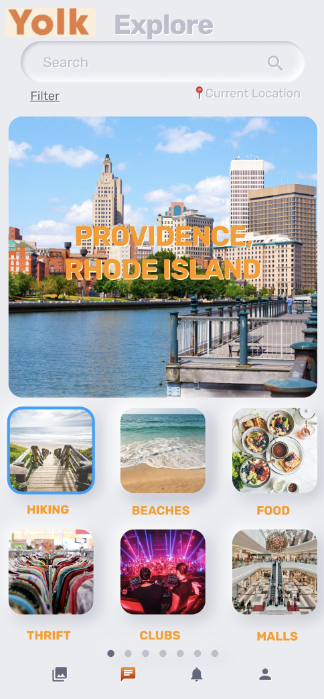
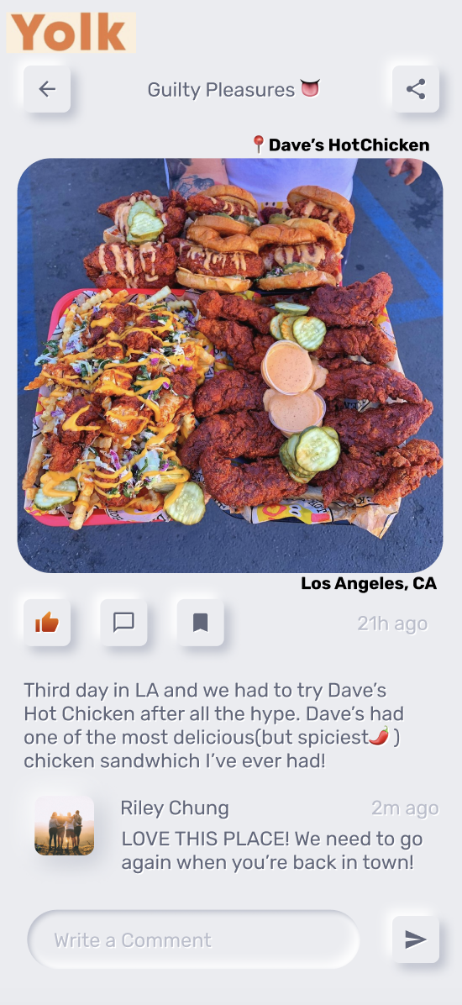
3
1. Select City
3. Connect
2. Curate Profile
4. Discover

Slide 4

4
Digitalize “word of mouth”
Curate lists of favorite spots
Connect with friends in new ways

Slide 5
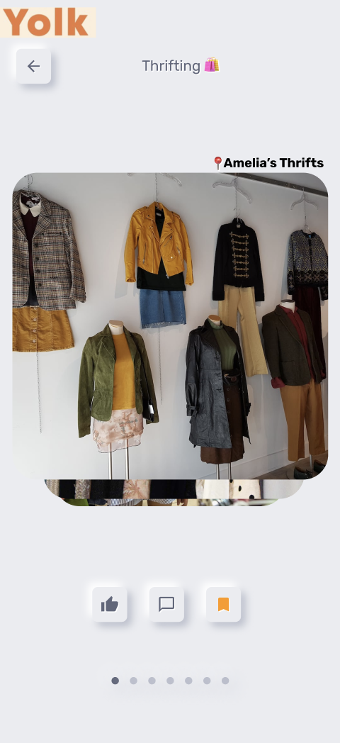
digitalize
“word of mouth”
5

Slide 6
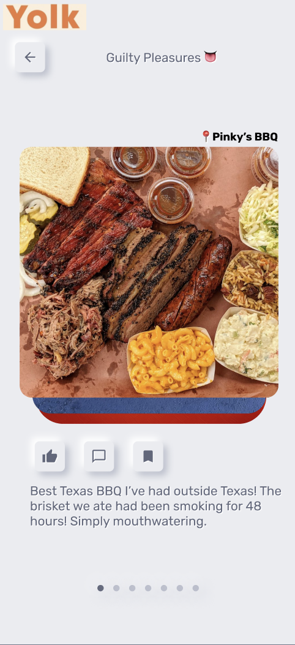
6
curate lists of
favorite spots

Slide 7
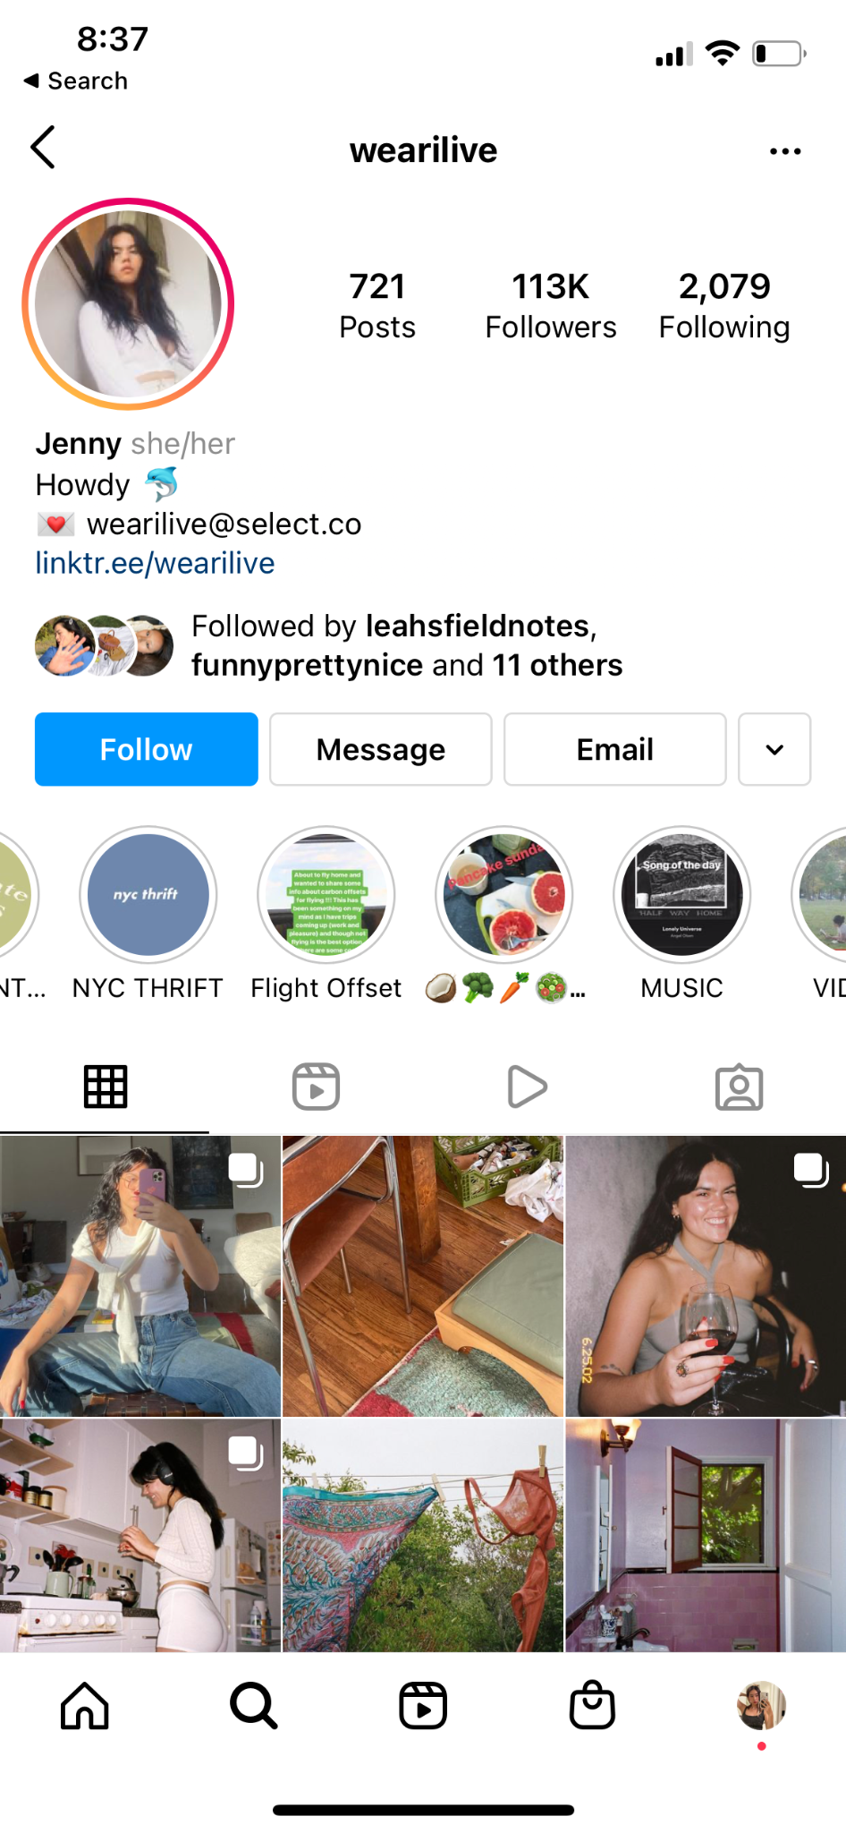
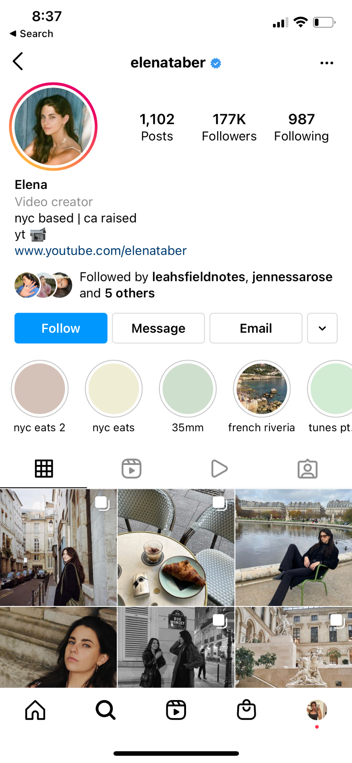

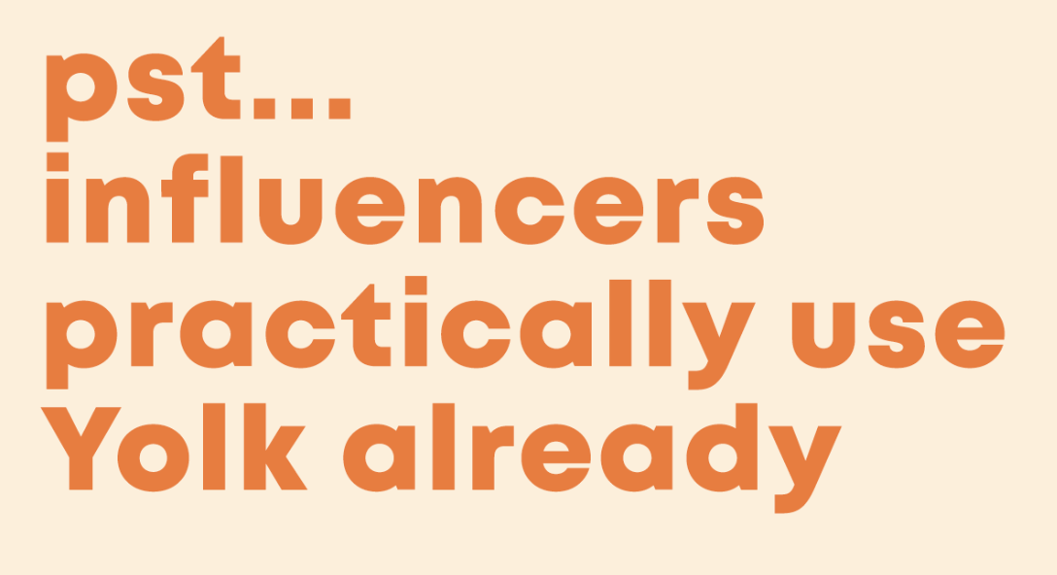
7

Slide 8
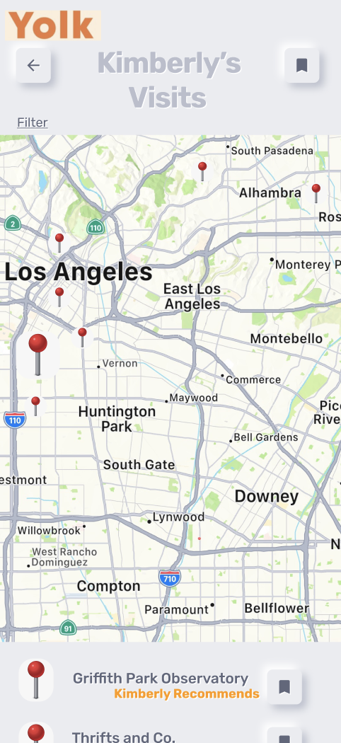
8
connect with
friends in new ways

Slide 9

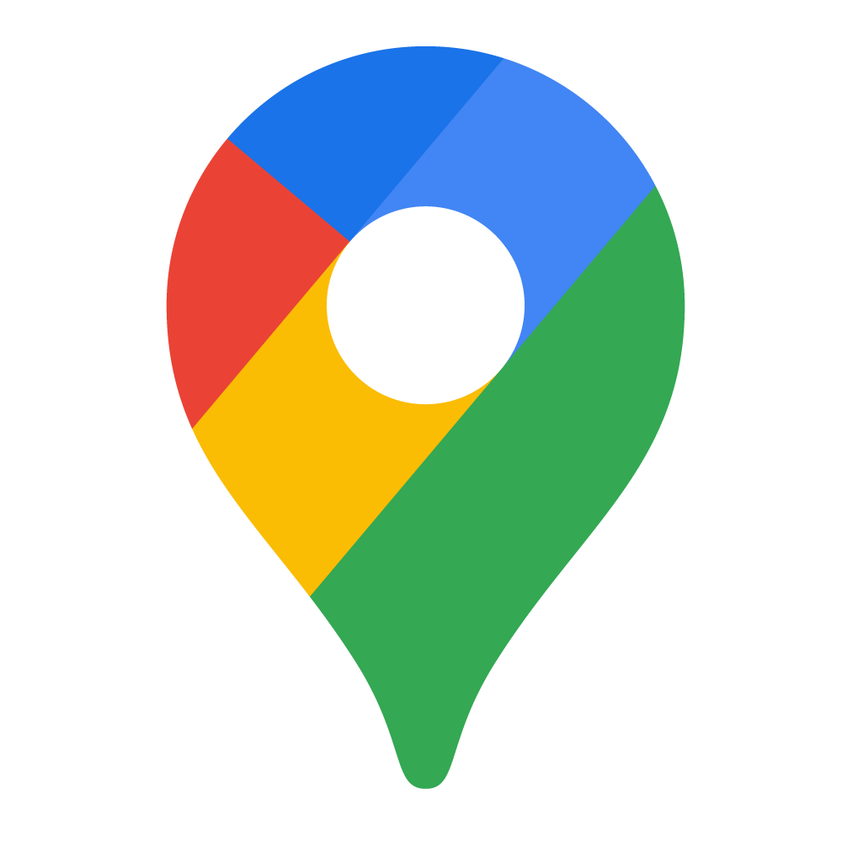
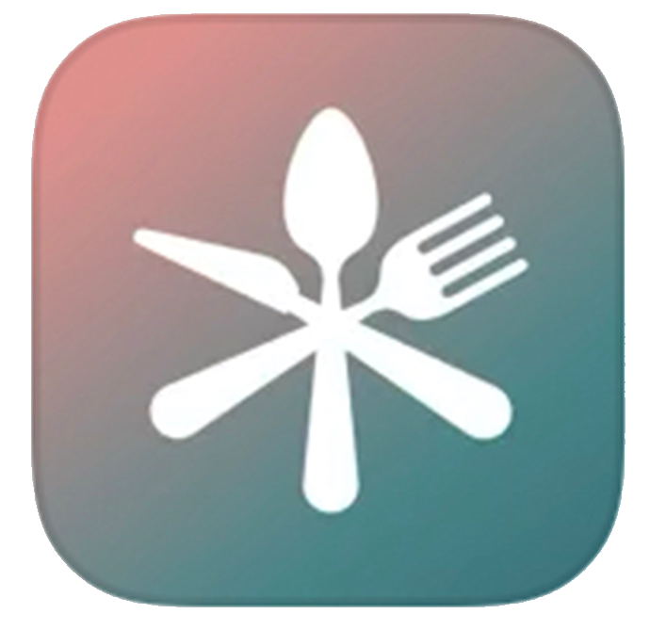


9
Indirect Competition
2. Direct Competition
Social Media Platforms
Recon Food
Search Engines

Slide 10
10
Why would businesses create profiles?
1. No Overall Rating
2. Cheap and targeted advertisements
Yolk gathers and collects various niche information
about users through their interactions
3. Passive “advertising” by users

Slide 11
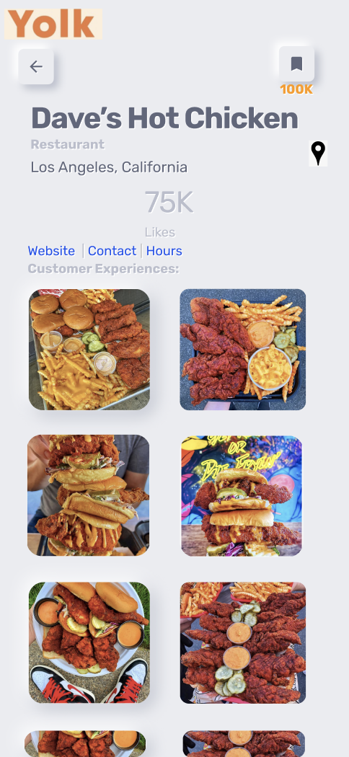
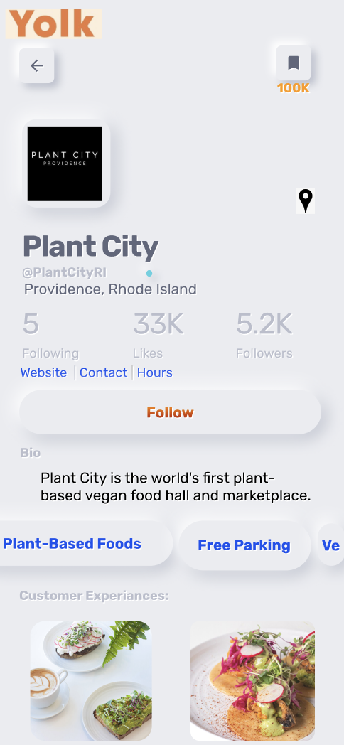
11
a culmination of customer experiences

Slide 12
12
Business Model
YolkBusiness- $20/monthly*
Allows businesses to access premium features on the app
Advertisements- $100-450/monthly*
Targeted ads that appear in user feed and searches
*per business

Slide 13
the plan: expansion
13
February 2022
March 2022
September 2022
Finish Technical
Development
Launch App in New York
Continue to
scale
Contact small and local influencers
June 2022
Launch App in
other big cities
Encourage local businesses to utilize and promote the App

Slide 16
RESERVE SLIDES

Slide 17
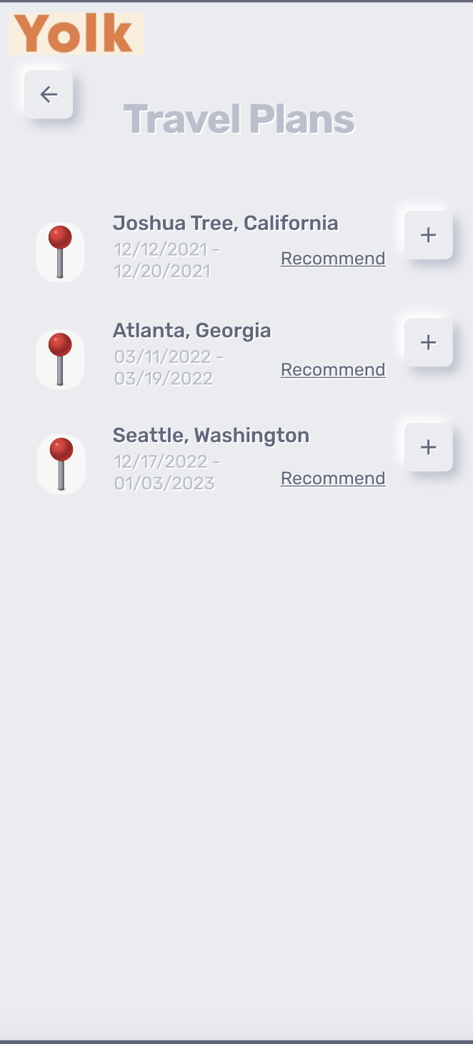
Effective and Targeted Ads
Notes:
https://instapage.com/blog/google-ads-vs-yelp-ads
https://www.k6agency.com/instagram-ads-cost/
https://www.wordstream.com/blog/ws/2021/07/12/facebook-ads-cost

Slide 18
Average Ad Costs
Network:
Yolk- $0.10-$1.75 $4.50
Facebook $0.25-$3.30 $7.19
Yelp- $3-$4 $6
Instagram- $0.20-$2 $6.70
CPC:
CPM:
Notes:
https://instapage.com/blog/google-ads-vs-yelp-ads
https://www.k6agency.com/instagram-ads-cost/
https://www.wordstream.com/blog/ws/2021/07/12/facebook-ads-cost

Slide 19
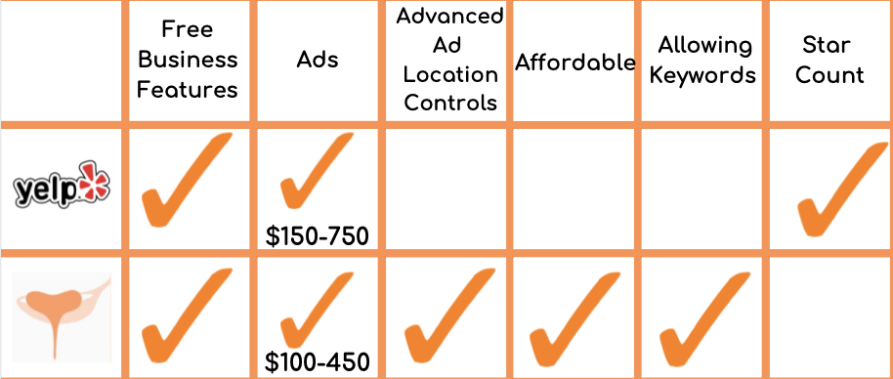
Compared to Yelp- Ad Structure
Notes:
https://instapage.com/blog/google-ads-vs-yelp-ads
https://www.k6agency.com/instagram-ads-cost/
https://www.wordstream.com/blog/ws/2021/07/12/facebook-ads-cost

Slide 20
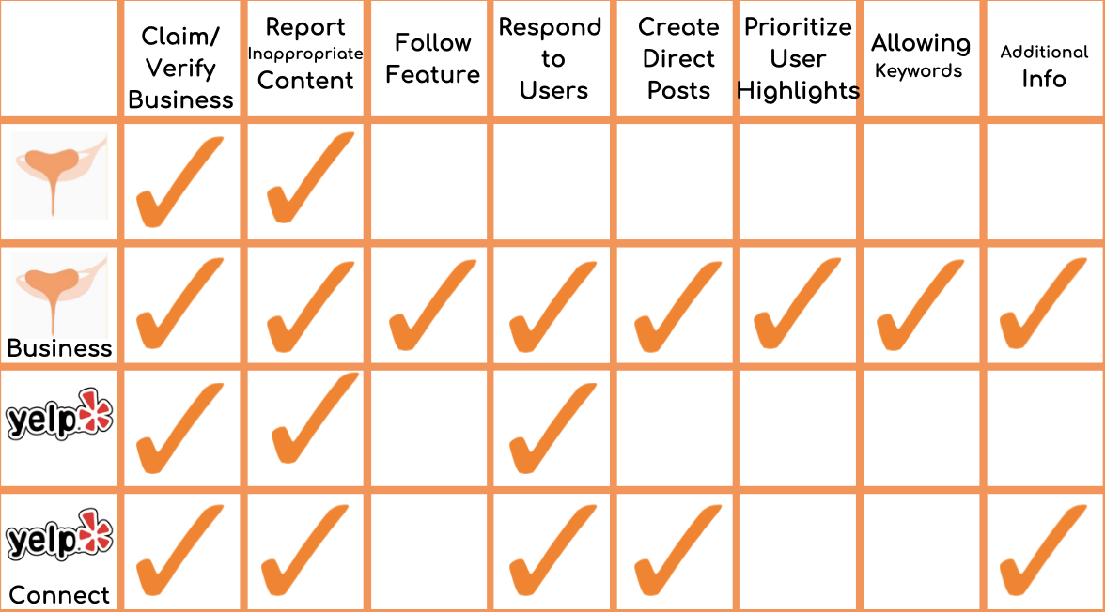
Compared to Yelp- Business Profile
$20/month
$99/month
Notes:
https://instapage.com/blog/google-ads-vs-yelp-ads
https://www.k6agency.com/instagram-ads-cost/
https://www.wordstream.com/blog/ws/2021/07/12/facebook-ads-cost

Slide 21
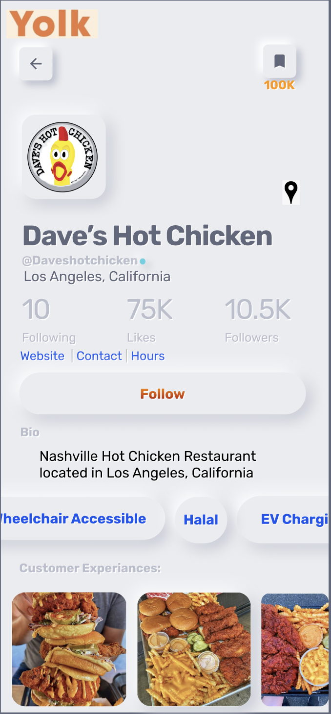
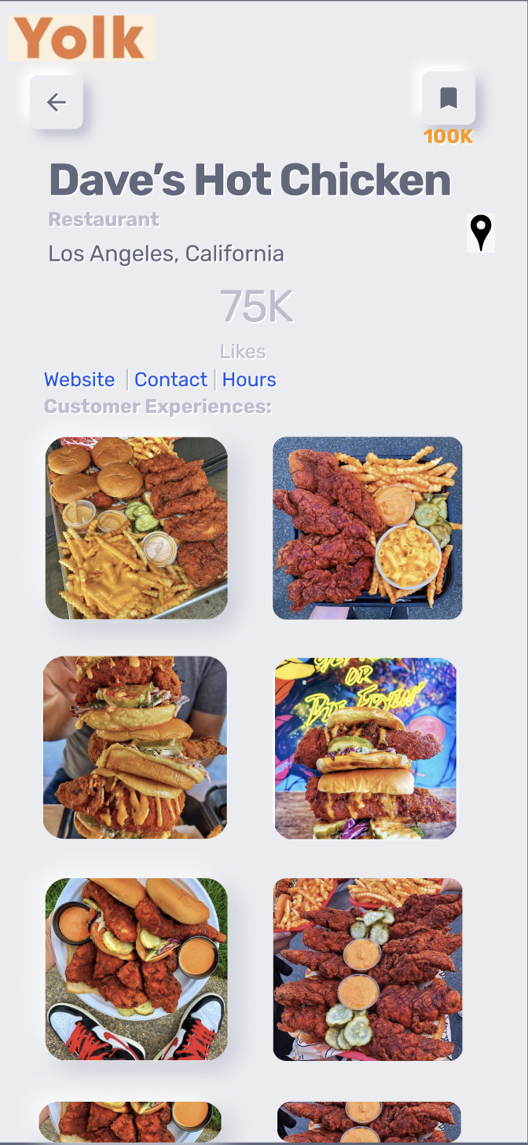

Slide 22
Business Incentives
No Overall Rating
Passive “advertising” by users
Cheap and targeted advertisements
Yolk gathers and collects various niche information about users through their interactions

Slide 23
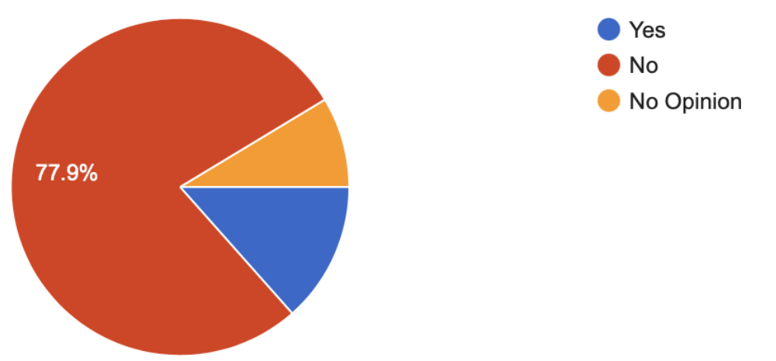
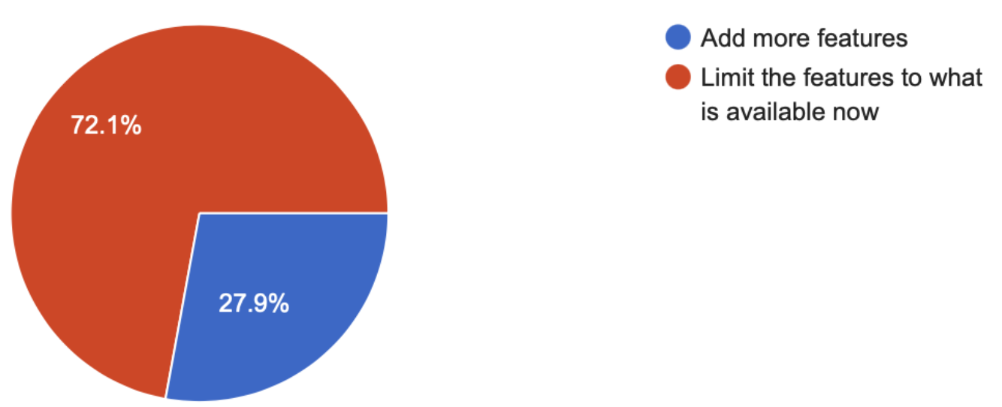
Instagram recently released a MarketPlace feature on their app, where users may buy and sell items on the social media app. Do you think this feature was a
necessary component to the app?
Do you believe that apps like Instagram, Facebook, or Twitter should add more features on their apps or limit them to what they have now?

